Slide 1

UPN, PASIÓN POR TRANSFORMAR VIDAS
PAST EXPERIENCES
Módulo 7
Pre-beginner 2
2022- 2
Videoconferencia 11
charito.chipana@upn.pe

Slide 2
Goals of the lesson
GETTING AWAY II
Students will be able to ...
At the end of the lesson you will be able to:
Talk about vacations activities.
Ask and answer questions to get information using Wh and the simple past of the verb be.

Slide 3
LOGRO DEL MODULO
Al finalizar la unidad, el estudiante demostrará su habilidad de describir las actividades que hizo en sus vacaciones, usando el verbo to be en pasado.

Slide 4
ACTIVIDADES DEL MODULO
At the end of the lesson you will be able to:
Talk about vacations activities.
Ask and answer Wh questions to get information using past tense of verb to be
Simple past of the verb to be
Padlet
Listening practice

Slide 5
IMPORTANCIA DEL LOGRO
El pasado simple se utiliza para hablar de una acción concreta que comenzó y acabó en el pasado. El estudiante demostrara su habilidad de hablar sobre las actividades que realizo en sus vacaciones usando el simple past.

Slide 6
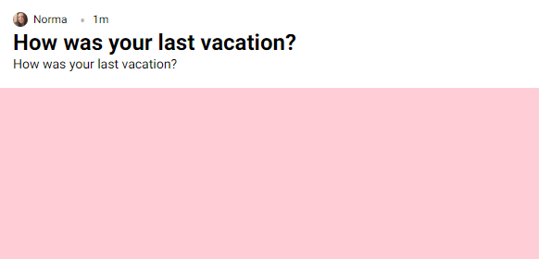
PADLET
HOW WAS YOUR LAST VACATION?
PADLET
https://padlet.com/normachipana71/kvdb8sanysyip6hk

Slide 7
Past Tense To Be
Pronouns | Verb To Be | Negative
I | was | wasn’t
You | were | weren’t
He | was | wasn’t
She | was | wasn’t
It | Was | wasn’t
We | were | weren’t
You | were | weren’t
They | were | weren’t

Slide 8
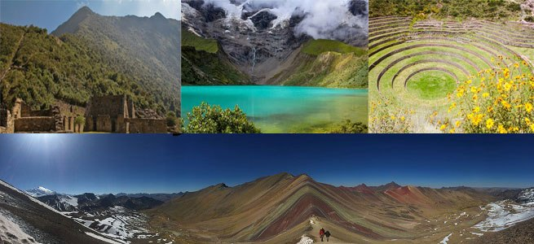
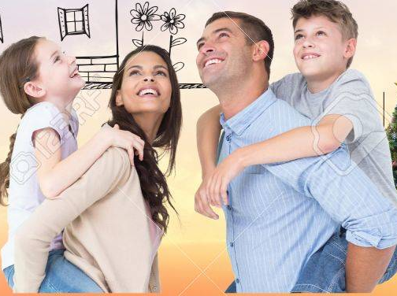
Our vacation in Cusco was fantastic!!
How was your last vacation?
The weather was cold.
Shopping was expensive.
Tourist attractions were interesting
People were friendly.

Slide 9
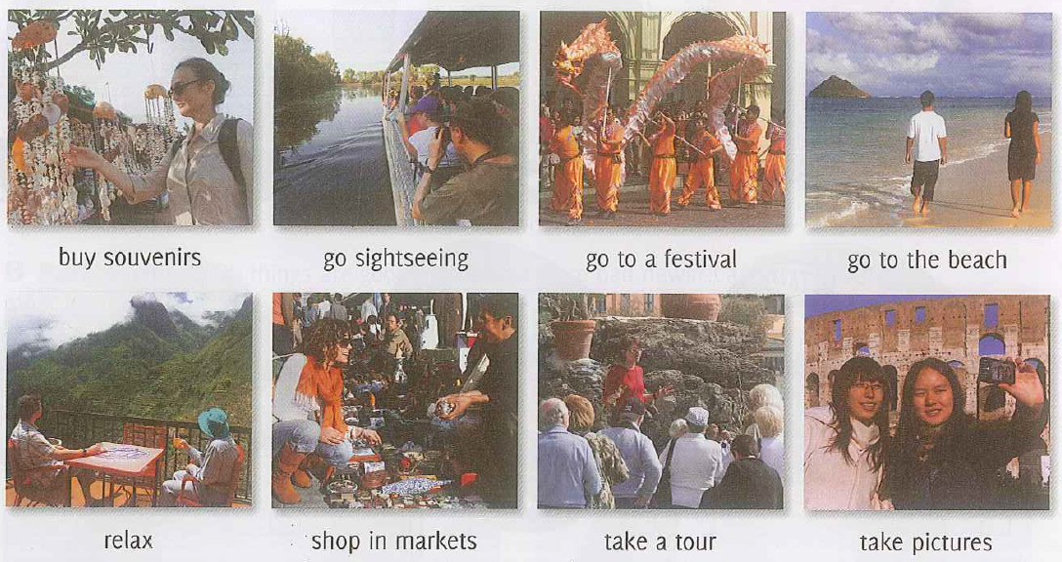
VACATION ACTIVITIES
I like going sightseeing! And you? What’s your favorite vacation activity?

Slide 10
GO: a. sightseeing b. to the beach c. pictures
Practice 1
Choose the word that doesn´t belong to:
TAKE: a. a tour b. a taxi c. sightseeing

Slide 11
RELAX: a. sightseeing b. at home c. a tour
Practice 1
Choose the word that goes with:
BUY: a. relax b. to the beach c. souvenirs

Slide 12
Let´s remember
QUESTIONS WORDS
Who = People
Where = Places
What = Things
When = Date / Time
How = Opinion

Slide 13
QUESTIONS WORDS
What
When
Who
Where
How

Slide 14

... were you born?
I was born in 1995.
Which
Who
What
Why
How
Where
When
Whose
NEXT

Slide 15
... were you yesterday?
I was at home.
Who
How
Which
Where
What
Whose
Why
When
NEXT

Slide 16
... was the class?
It was very interesting.
Why
When
How
What
Which
Who
Where
Whose
NEXT

Slide 17
... were your favorite cartoons?
Candy and the Thundercats.
Who
Where
Whose
Why
Which
What
When
How
NEXT

Slide 18
... was she absent?
Because she was ill.
Who
Where
Whose
Why
When
How
What
Which
NEXT

Slide 19
... was your best friend at school?
My classmate Jane.
Why
What
Which
Where
Who
How
Whose
When
NEXT

Slide 20
WH- questions
WH- word | was were | Subject | Complement?
What | was | your favorite cartoon | in the 90s ?
Where | were | your friends | last night?
How | was | the weather | yesterday?

Slide 21
PADLET
HOW WAS YOUR LAST VACATION?
PADLET
https://padlet.com/normachipana71/kvdb8sanysyip6hk

Slide 22
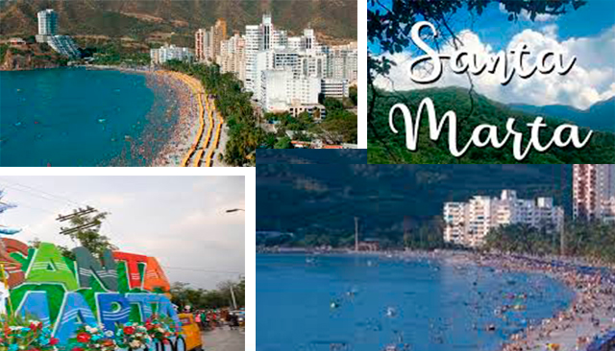
Complete the postcard with the correct form of the verb TO BE: WAS/ WERE
Complete with was or were
My name is Ann. Last summer I _____ in Santa Martha.
The weather _________ sunny. I ______ with my two brothers.
It _______ fantastic to swim in the beach.
My friends _______ sad because they weren´t with me.
There _______ many places to visit. I went to different stores.
The shopping ______ expensive.
My trip _______ really unforgettable.
was
was
was
was
were
were
was
was

Slide 23
How was your weekend?
It was great!
Where were you?
I was in Miami

Slide 24
Where were you last Saturday?
We were in a restaurant.

Slide 25
How was the food?
It was | delicious
 | tasty
 | satisfying
 | exquisite

Slide 26
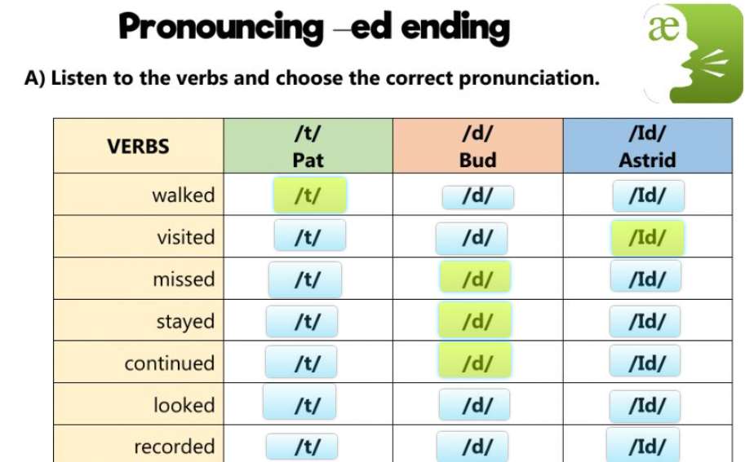
Pronunciation regular verbs -ed ending Listen to the verbs and practice
https://es.liveworksheets.com/worksheets/en/English_as_a_Second_Language_(ESL)/Pronunciation_of_past_-ed/Pronunciation_regular_verbs_-ed_ending_jf7317jf

Slide 27
Getting Away II
Let’s check what we’ve learned
FEEDBACK

Slide 28
FEEDBACK
What did we learn? Can you give examples of the following structures?
At the end of the lesson you will be able to:
Talk about vacations activities.
Ask and answer Wh questions to get information using past tense of verb to be
Simple past of the verb to be
Listening practice

Slide 29
WH- questions
WH- word | was were | Subject | rest of the question ?
What | was | your favorite cartoon | in the 90s ?
Where | were | your friends | last night?
How | was | the weather | yesterday?

Slide 30
RECORDATORIO
Se viene la T4 (Del 13/JUN - 13:00 Hasta 20/JUN - 13:00). Incluye la semana 11, 12 y 13. recordarles que todos los materiales explicados en vivo y los nuevos contenidos para complementar los materiales del curso están en Mis Video conferencias.

Slide 31
Material complementario nuevos contenidos
Past simple: Regular and irregular verbs https://www.english-4u.de/en/tenses-exercises/past-simple4.htm Past simple YES /NO questions https://www.perfect-english-grammar.com/past-simple-exercise-5.html

Slide 32
Do you have any question?

Slide 33
UPN, PASIÓN POR TRANSFORMAR VIDAS
charito.chipana@upn.pe
Universidad Privada del Norte

Slide 34
UPN, PASIÓN POR TRANSFORMAR VIDAS
PAST EXPERIENCES
Módulo 7
Pre-beginner 2
2022- 2
Videoconferencia 11
Material producido por: Norma Chipana Peceros
charito.chipana@upn.pe
Universidad Privada del Norte

Slide 35


